Slide 1
HOSPITAL RE-ADMISSION PREDICTION AND ANALYSIS
By:- Praful Sharma

Slide 2
Outline
Introduction to the problem
Data source and exploration
Data pre-processing and Model building
Evaluation and comparison
Summary

Slide 3

Introduction to the problem

Slide 4
What?
A leading US hospital seeing increasing number of re-admission.
Re-admission penalty for more number of readmission by CMS.
Can affect the reputation of hospital.
Increased cost to the insurance companies

Slide 5
How?
By classifying potential patients into re-admission and no re-admission.
By giving most important features that are common in all re-admitted patients.
Hospital can later investigate and take proper care of patient that are predicated as re-admission by our methods.

Slide 6

Data source and exploration
CSV

Slide 7
Data Source
Demographic data i.e. race, age group, weight etc.
Hospitalization data i.e. admission date, discharge date etc.
Diagnosis data i.e. medication details, lab test results etc.
Record of 34650 patients between year 2014 – 2016.
Readmitted column is highly imbalanced.
Missing values in the form of ‘?’.

Slide 8
Data Exploration
Some columns have highly skewed distribution.
Some columns have more than 40 % – 50 % missing values.
Diagnosis column’s have ICD(International Classification of Diseases) codes that represent type of disease and too many levels to work with.

Slide 9
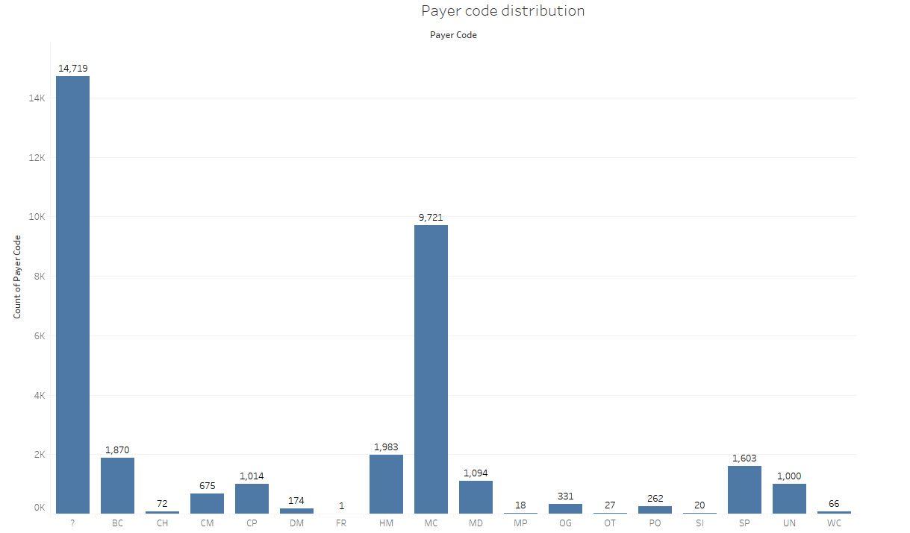
Payer Code
More than 40 percentage of values are missing.

Slide 10
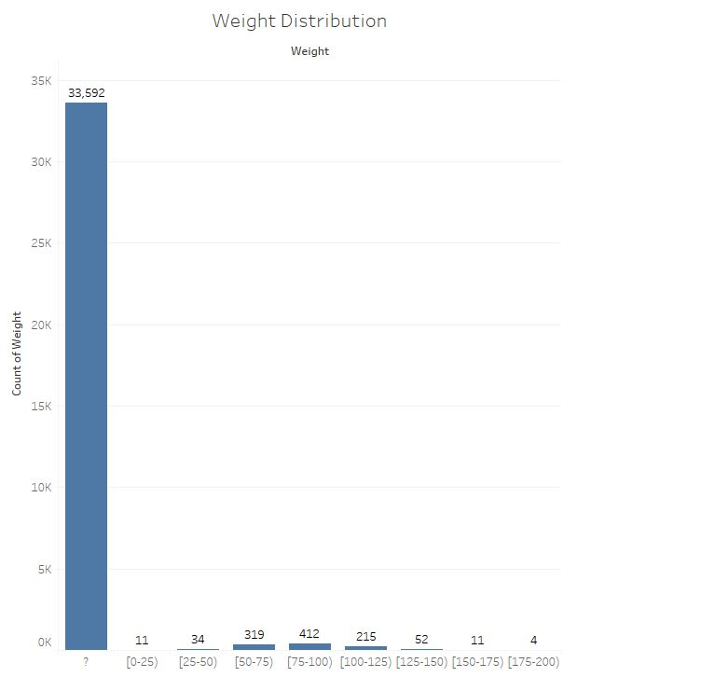
Weights Distribution
More than 95 percentage values are missing.

Slide 11
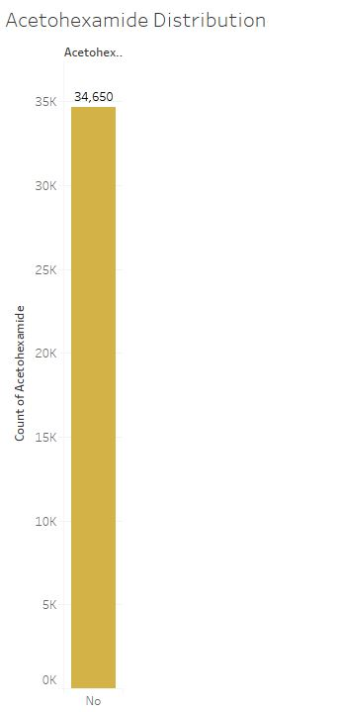
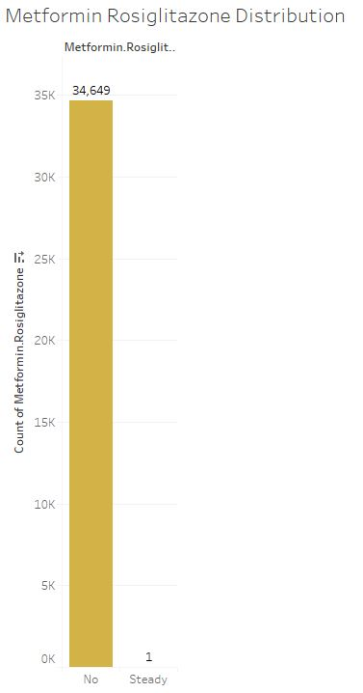
Acetohexamide and Metformin Rosiglitazone Distribution
Both doesn’t have any information or prediction power.

Slide 12
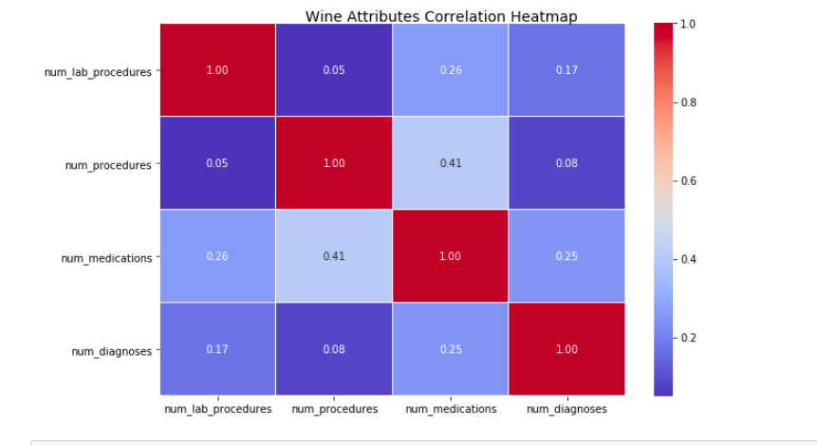
Co – relation of different numerical columns
Correlation Heat map
There is no high co – related column.

Slide 13
Data Pre-Processing and Model Building
A repeated process

Slide 14
Data Pre-Processing - I
Removal of columns that has no information or high number of missing values.
Removal of diagnosis code columns.
Imputation of race column with logistic model.
Creation of new attribute Number of Days Spent from admission date and discharge date.

Slide 15
Data Pre-Processing - II
Later, Introduced two new variables Month of Admission and Number of Medication Change.
Merged multiple diagnosis codes into 19 different categories based on International Code for Disease.
MICE imputation
Month of Admission and diagnosis categories turned out important variables to classify the patient in Random forest.

Slide 16
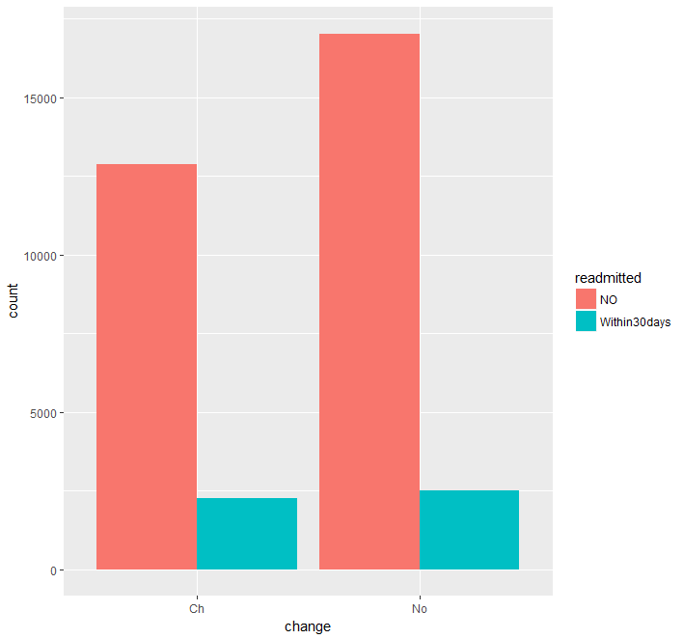
Intuition behind Number of Medication Change variable
High proportion of Within30days

Slide 17
Model Building Approaches
Intuition was to provide a fuzzy model for better interpretability.
Algorithms used:
Logistic Regression
Naïve Base
C50(Decision Tree)
SVM(Decision Tree)
Random Forest
Dealing with Class Imbalance :
Cost Sensitive learning
SMOT
Up and Down sampling
Hyper – Parameter Tuning(class weights, number of trees etc.)
Hold out and 5 – fold validation

Slide 18
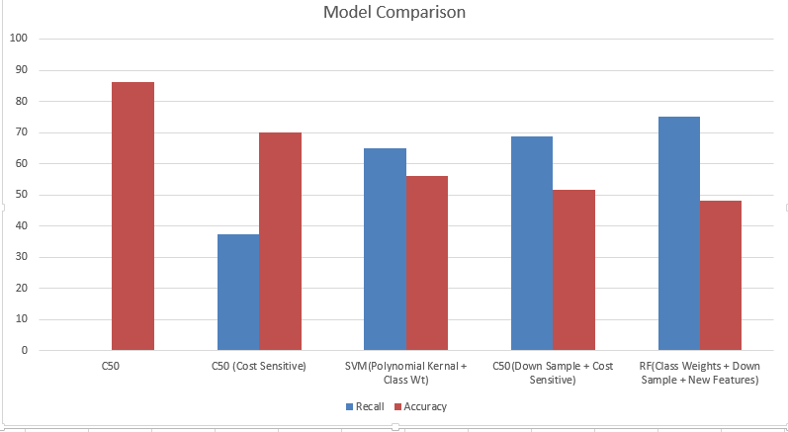
Validation results of some model
Result includes some hold – out some 5 fold validation results

Slide 19
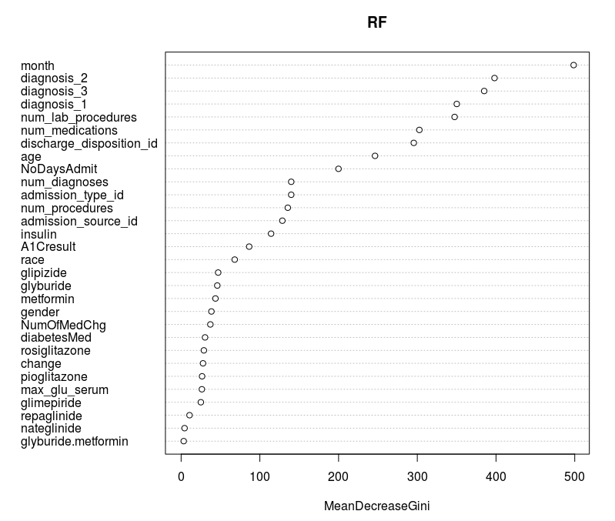
Important variable based on mean decrease in GINI

Slide 20
Thank You

